Slide 1
HelpPlus
A social media and Government app

Slide 2


1. Intro
HelpPlus is a Internet based application that will make communication between Government authorities and citizens more simple by using the power of social media.

Slide 3
How many of us know which government authority to contact when we are in some trouble

Slide 4

The HelpPlus app will use the power of social network to suggest users the authorities and simple way to contact them, and vise versa.

Slide 5
2. Example Scenario 1
Suppose a scenario like someone got stuck in train and looking for help using different mediums like facebook, twitter or any forum, with this app they don’t need to follow every medium for help this will be single place for them to post their problems to most of the well known social platforms with their location and other important updates.
Anyone or Govt. Authorities can reach them with in.

Slide 6
2. Example Scenario 2
Another scenario; suppose in case of any natural calamity and people looking for help. The application will help them get update from authorities and also let others know who all are in need.
Every one who will be concerned about anyone can assure their security.

Slide 7

Meet Shalini.
He recently travelling from Delhi to Kolkata by train.
She was feeling little insecure with her fellow passenger but she didn’t know to whom to contact to get the best assistance.
He loved soccer, but feared he had no way to talk to a coach or teammates.

Slide 8

This lack of knowledge made her uncomfortable in her pleasant journey.

Slide 9
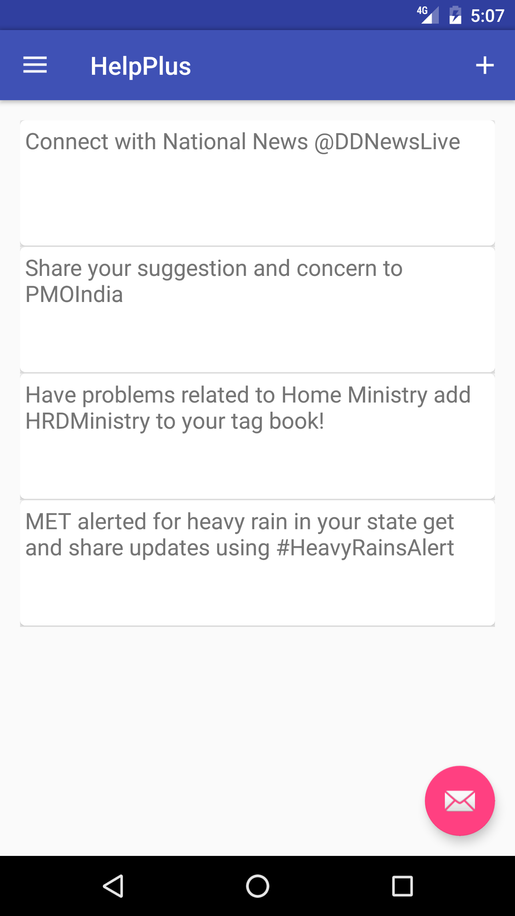
Then, Shalini discovered HelpPlus
She visited the app and posted her concern to respective authority and got instant attention.
Everyone in her circle are now not confirmed about her security.

Slide 10
It’s excellent feeling to help others, there is a lot you can do help your people.

Slide 11
Milestones
July 2016
August 2015
Provided twitter as a medium to post updates.
2016
Users getting alert notifications from authorities

Slide 12
What’s next
Enabling users to post on more social platforms.
Adding feature of Emergency alert.
2016
Adding feature to allow user to share exact location.
Adding feature to message personally to user.
And lot more helpful feature in pipeline!

Slide 13
Thank you!

